Slide 1
Open Targets: integrating genetics, omics and chemical data for drug discovery
C4X Discovery
June 18th 2019
Denise Carvalho-Silva, PhD
EMBL-EBI | Open Targets
Wellcome Genome Campus
United Kingdom
Notes:
C4X: inflammation, oncology, neurodegeneration

Slide 2
This session 10:00-15:00
Introduction to Open Targets
Open Targets Platform: presentation + live demos
Hands-on exercises
Lunch break → 12:00-13:00
Open Targets Genetics: presentation + live demo
Feedback survey, wrap up, further discussion

Slide 3
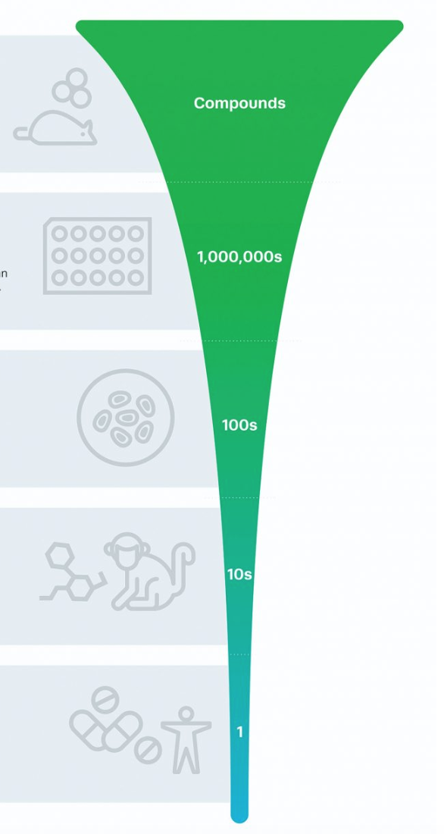
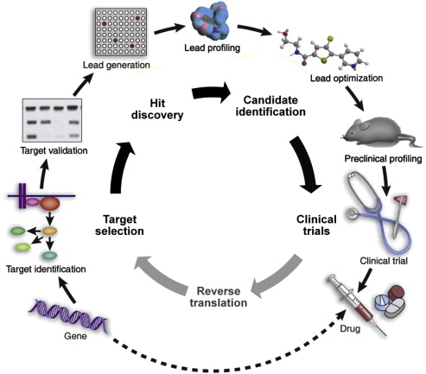
Drug discovery R&D
DOI: 10.1016/j.molonc.2012.02.004
Lengthy, costly, high attrition
https://www.genengnews.com/insights/how-crispr-is-accelerating-drug-discovery/
Notes:
PhaRMA
Lengthy: Drug discovery from start (idea) to finish (market) can take up to 15 years.
Costly: specially from clinical trials when human subjects are tested (volunteers or suffering from the condition)
Compounds drop out along the drug discovery journey → low success, high attrition
Funnel: https://www.genengnews.com/insights/how-crispr-is-accelerating-drug-discovery/
Cycle: DOI: 10.1016/j.molonc.2012.02.004

Slide 4
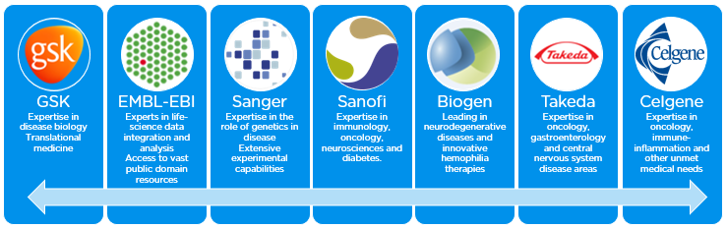
Open Targets
A partnership to transform drug discovery
Founded in 2014
Founding partners
2018
2016
2017
2018
Systematic identification and prioritisation of targets
Notes:
A shared vision to create a partnership to transform drug discovery through systematics target ID and prioritisation.
From that idea Open Targets (formerly CTTV) was started to combine the world class functional genomics expertise at Sanger with the EBI‘s excellence in bioinformatics and computational biology and the industry expertise of GSK and now Biogen as well with the aim to find out all that‘s important about a target before starting the drug development pipeline.
Thereby the pipeline would be filled with validated and valid targets with a much improved odds ratio for success.

Slide 5
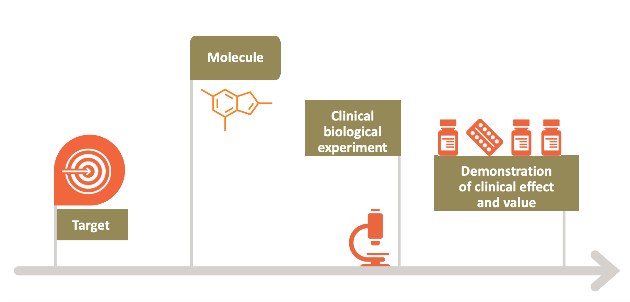
Selecting the right target

Slide 6

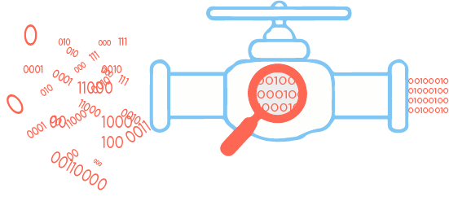





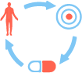





Knowledge cycle
Public data
Experimental projects
Bioinformatics projects
DATA
GENERATION
DATA
INTEGRATION
Therapeutic hypothesis
https://www.targetvalidation.org
https://genetics.opentargets.org
Notes:
Target ID and prioritisation knowledge cycle.
Our research focusses on data generation, data integration, and enabled data access
Our research is connected as we provide the tools to generate hypothesis and explore them experimentally
We focus primarily on oncology, immunology (including IBD) neurodegeneration with some experiments in other areas or across diseases

Slide 7
Data generation: Open Targets
Some examples
Organoid knockouts (CRISPR-Cas9) - gut epithelium
IL22 pathway to treat IBD?
Wellcome Sanger Institute, GSK, University of Cambridge
Alzheimer’s and Parkinson’s
CRISPR/Cas9 screens, iPS cells
Wellcome Sanger Institute, Biogen, Gurdon Institute
> 1,000 cancer cell lines + biomarkers + tractability
RNASeq, CRISPR/Cas9 screens
Wellcome Sanger Institute, GSK and EMBL-EBI
www.opentargets.org/science/

Slide 8
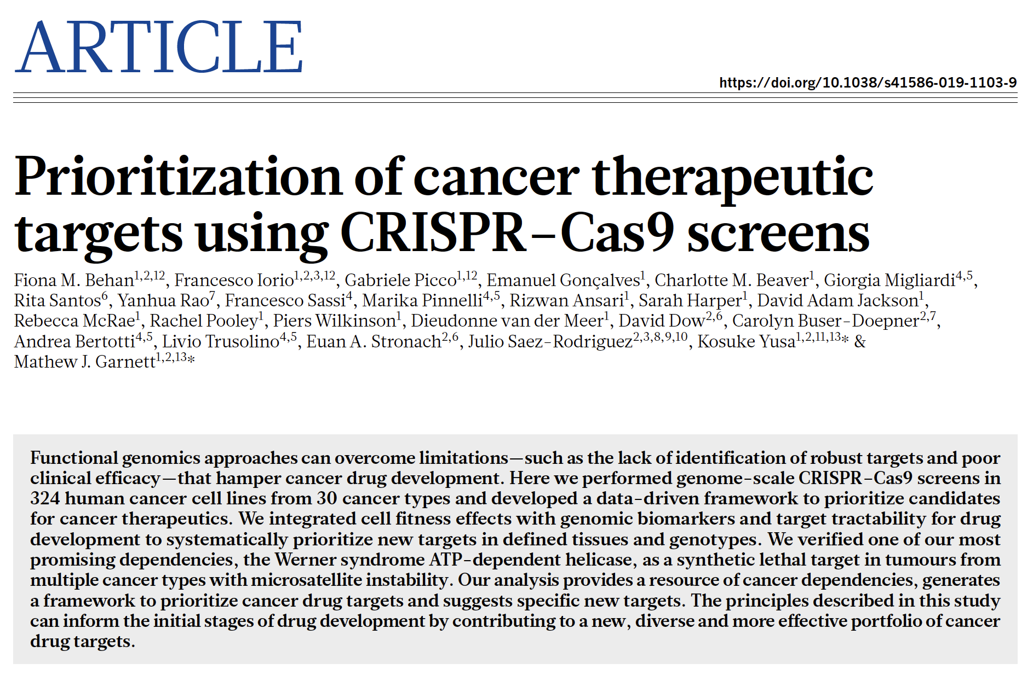

Data generation: Oncology

Slide 9
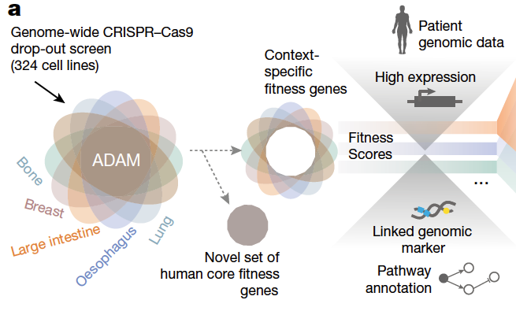
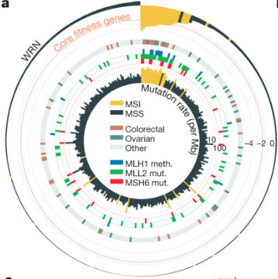
Behan et al (2019)
Data now available in the Open Targets Platform e.g.
https://www.targetvalidation.org/evidence/ENSG00000100941/EFO_0000305?view=sec:affected_pathway
WRN sustains in vivo growth in:
colorectal
ovarian
endometrial
gastric
New candidate target for tumours with MSI (WRN antagonists)

Slide 10
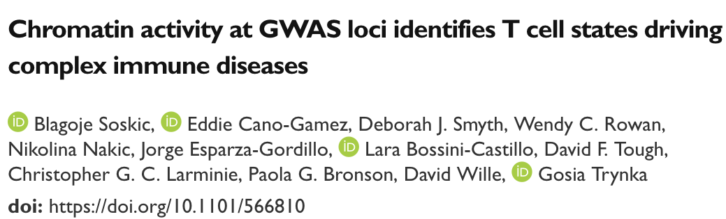
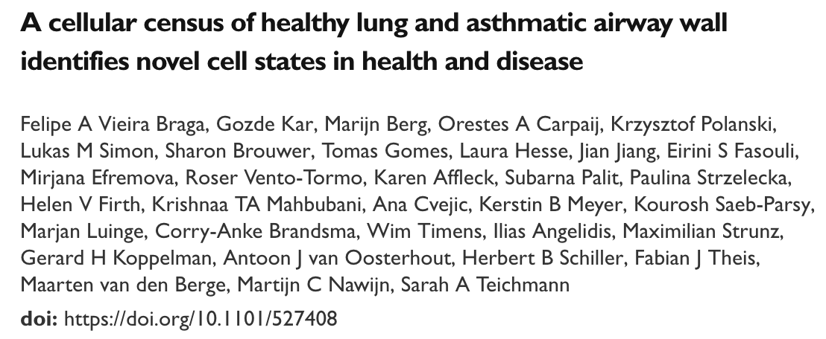
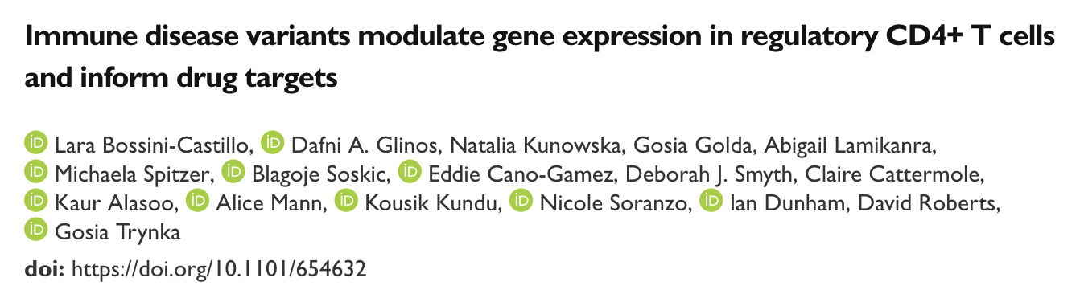
Open Targets preprints

Slide 11
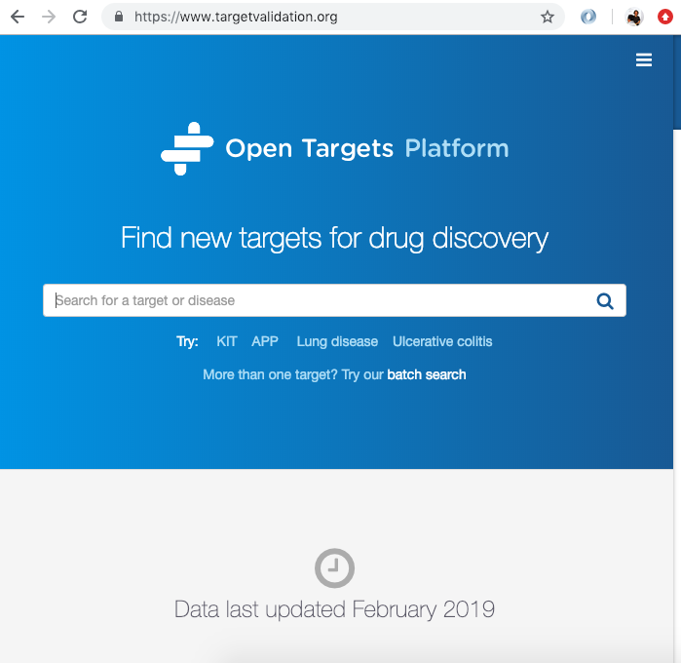
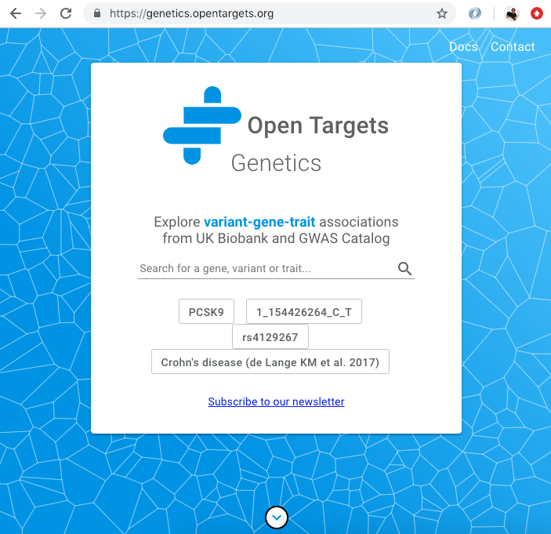
Data integration: web resources
Data integration: Open Targets
https://www.opentargets.org/resources/#open-targets-platform

Slide 12
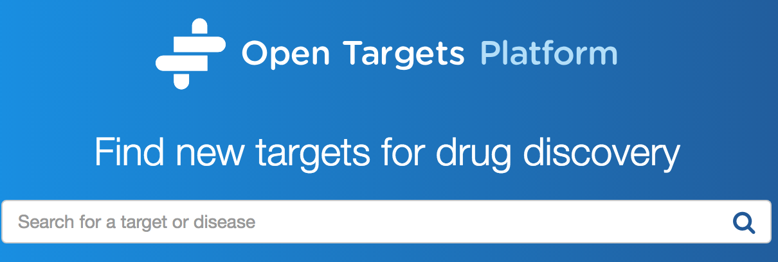
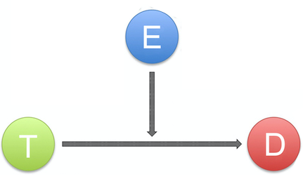
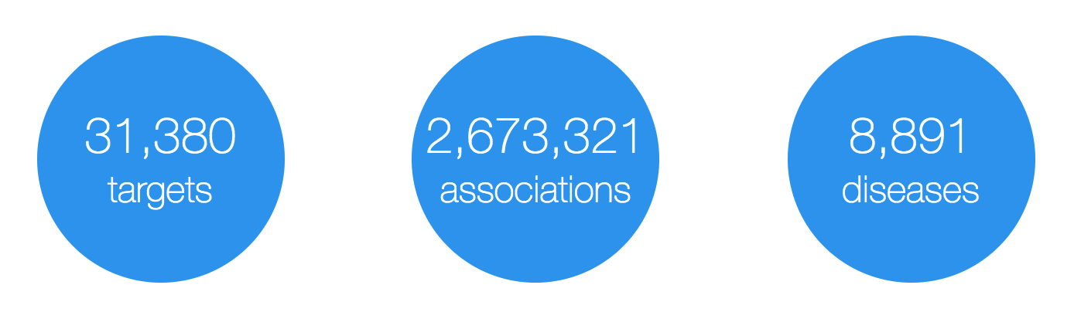
Evidence
https://www.targetvalidation.org
Target
Disease

Slide 13
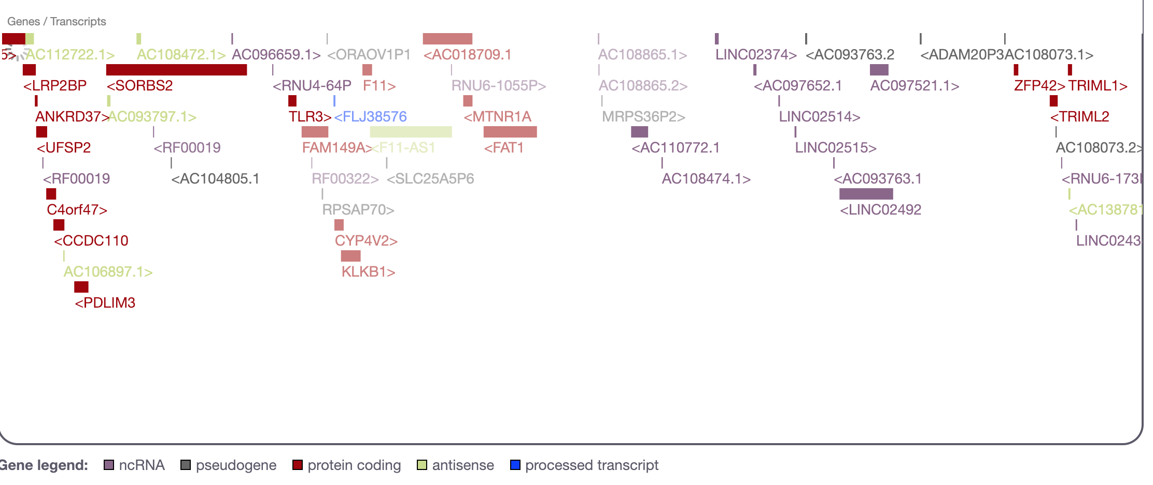
What is a target?
28K
targets
Examples
https://www.targetvalidation.org/target/ENSG00000255248
https://www.targetvalidation.org/target/ENSG00000175482?view=sec:genome_browser
Notes:
HGNC names e.g. DMD (synonyms)
Ensembl Gene IDs e.g. ENSG00000105641
UniProt IDs e.g. P15056
Non-coding genes e.g. MIR100HG

Slide 14
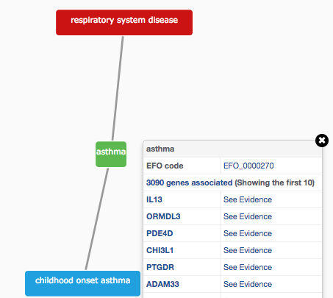
How do we describe our diseases?
Modified version of Experimental Factor Ontology (EFO)
Controlled vocabulary (Coeliac versus Celiac)
Hierarchy (relationships)
Promotes consistency
Increases the richness of annotation
Allow for easier and automatic integration
10K
diseases
Notes:
The choice of our disease ontology was EFO. It is cross-referenced against DO, OMIM, HP, MP, MONDO as well

Slide 15
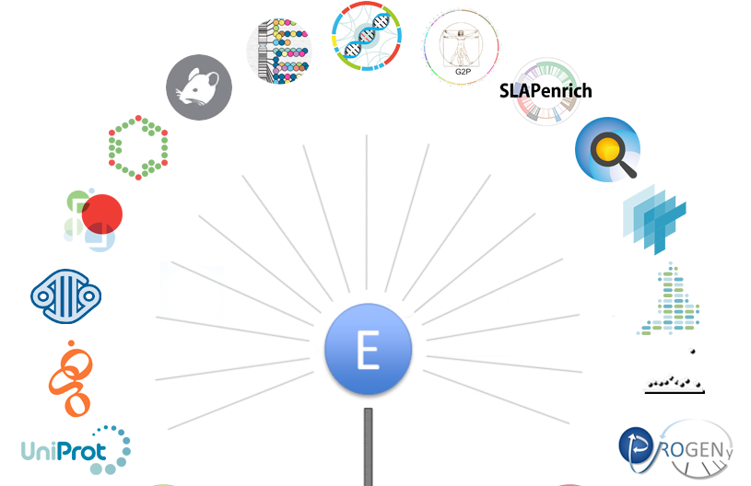
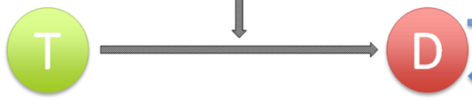
Evidence for our T-D associations
https://docs.targetvalidation.org/data-sources/data-sources
Notes:
Evidence: sequence (SNPs, mutations, germline and somatic curated at the DNA or protein level), differential mRNA expression, sentences from research papers, drug information, pathways affected by pathogenic mutation, animal models (https://github.com/opentargets/json_schema)

Slide 16
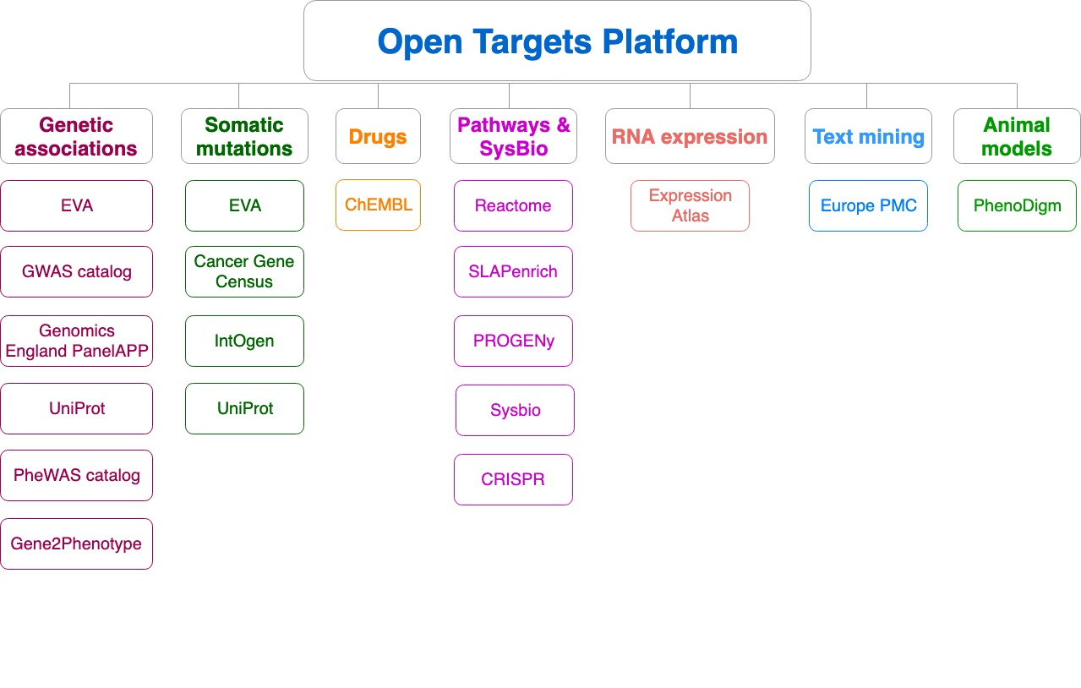
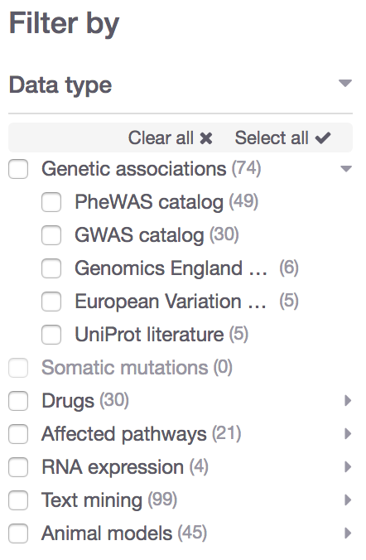
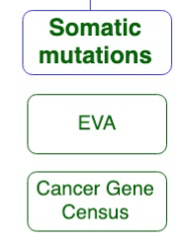
Data sources grouped into data types
Data type
Data source
https://docs.targetvalidation.org/data-sources/data-sources

Slide 17

What can you do with the Open Targets Platform?
Target-disease associations (+ evidence + score)
https://www.targetvalidation.org/evidence/ENSG00000141510/EFO_0000228
Target annotations
http://www.targetvalidation.org/target/ENSG00000141510
Disease annotations
http://www.targetvalidation.org/diseaset/EFO_0000228

Slide 18
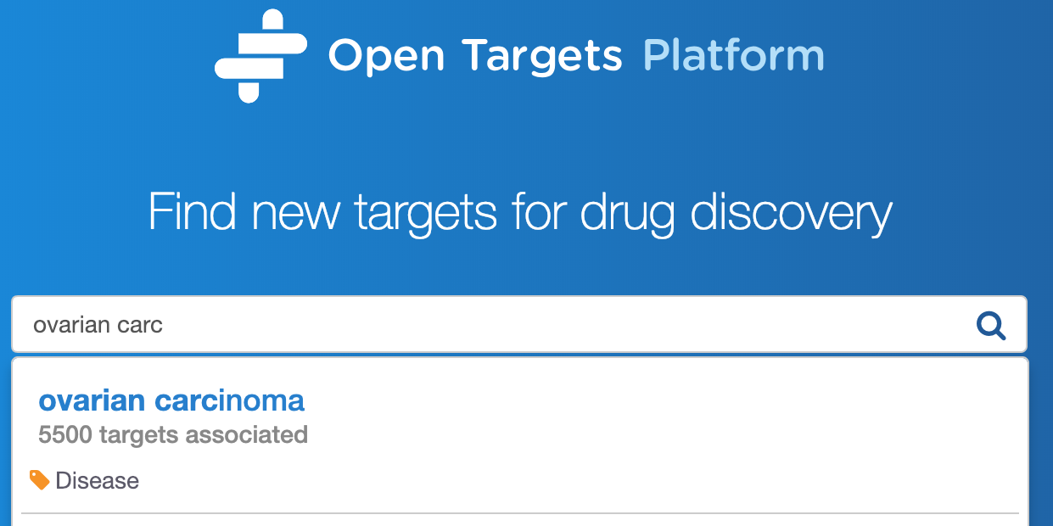
Demo 1
Searching for a disease → targets
Which targets are
associated with my disease?
What is the evidence for the association?
Is there any data to help me with target prioritization e.g.
tractability?

Slide 20
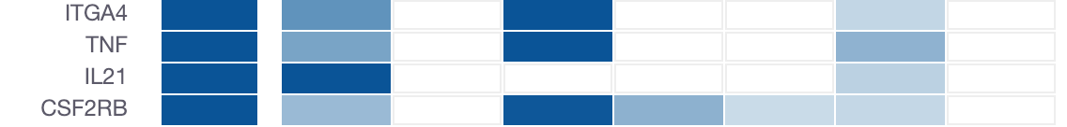
Association score → confidence
Which targets have more evidence for an association?
What is the relative weight of the evidence for different targets?
Overall score
Genetic
Somatic
Drugs
Pathways
Expression
Text mining
Animal mod

Slide 21
Four-tier framework
Σ_{H}
*1.0
Genomics England
Score: 0 to 1 (max)
Σ_{H}
*1.0
PheWAS catalog
Σ_{H}
*1.0
European Variation Archive (germline)
Σ_{H}
*1.0
Σ_{H}
Genetic associations
Calculated at four levels:
Evidence
Data source
Data type
Overall
UniProt
Σ_{H}
*1.0
Gene2Phenotype
Σ_{H}
*1.0
GWAS catalog
Σ_{H}
*1.0
Cancer Gene Census
Σ_{H}
*1.0
European Variation Archive (somatic)
Σ_{H}
Somatic mutations
Σ_{H}
*1.0
IntOGen
Aggregation with (harmonic sum)
Σ_{H}
Σ_{H}
*1.0
ChEMBL
Drugs
Σ_{H}
*1.0
Reactome
Note: Each data set has its own scoring and ranking scheme
Σ_{H}
*0.5
SLAPenrich
Σ_{H}
*0.5
Σ_{H}
Pathways &
systems biology
PROGENy
Σ_{H}
*0.5
Sysbio
Σ_{H}
*0.2
Expression Atlas
RNA expression
Σ_{H}
*0.2
Europe PMC
Text mining
Σ_{H}
*0.2
PhenoDigm
Animal models
weight factor
Σ_{H}
S₁ + S₂/2² + S₃/3² + S₄/4² + S_{i}/i²
Σ_{H}
Association

Slide 22
From evidence to overall score
Statistical integration, aggregation and scoring
1) Evidence score (e.g. one SNP from a GWAS paper)
2) Data source score (e.g. all SNPs from the GWAS catalog)
3) Data type score (e.g. all sources of Genetic associations)
4) Overall association score
https://docs.targetvalidation.org/getting-started/scoring

Slide 23

Computing the score for one evidence
score = f * s * c
f, relative occurrence of a target-disease evidence
s, strength of the effect of the variant
c, confidence of the observation for the target-disease evidence
f = sample size (cases and controls)
s = predicted functional consequence (VEP)
c = p value reported in the paper
(Factors affecting the relative strength of GWAS Catalog evidence)
https://docs.targetvalidation.org/getting-started/scoring

Slide 24
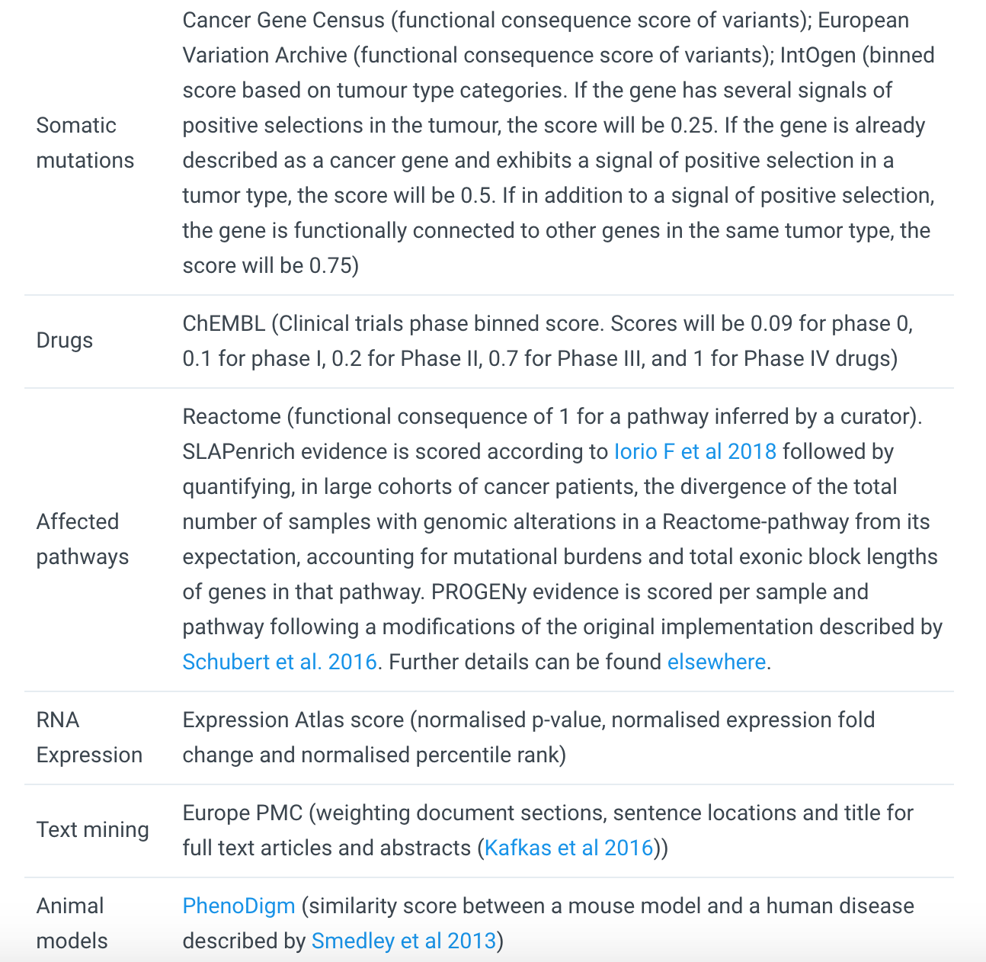
https://docs.targetvalidation.org/getting-started/scoring
Factors affecting the relative strength of the evidence

Slide 25
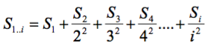
Aggregating scores across the data
Using a mathematical function, the harmonic sum*
where S1,S2,...,Si are the individual sorted evidence scores in descending order
Advantages:
A) account for replication
B) deflate the effect of large amounts of data e.g. text mining
* PMID: 19107201, PMID: 20118918

Slide 26






Target-Disease Association Score
EuropePMC
(Text Mining)
UniProt
(Manual Curation)
Overall
association
score
ChEMBL
(Manual Curation)
VERY simplified diagram
By Andrea Pierleoni

Slide 27


Slide 28
What can you do with the Open Targets Platform?
Target-disease associations (+ evidence + score)
https://www.targetvalidation.org/evidence/ENSG00000141510/EFO_0000228
Target annotations
https://www.targetvalidation.org/target/ENSG00000141510
Disease annotations
https://www.targetvalidation.org/diseaset/EFO_0000228

Slide 29
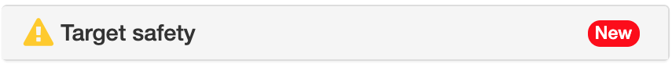
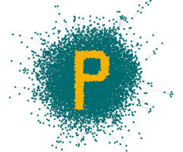
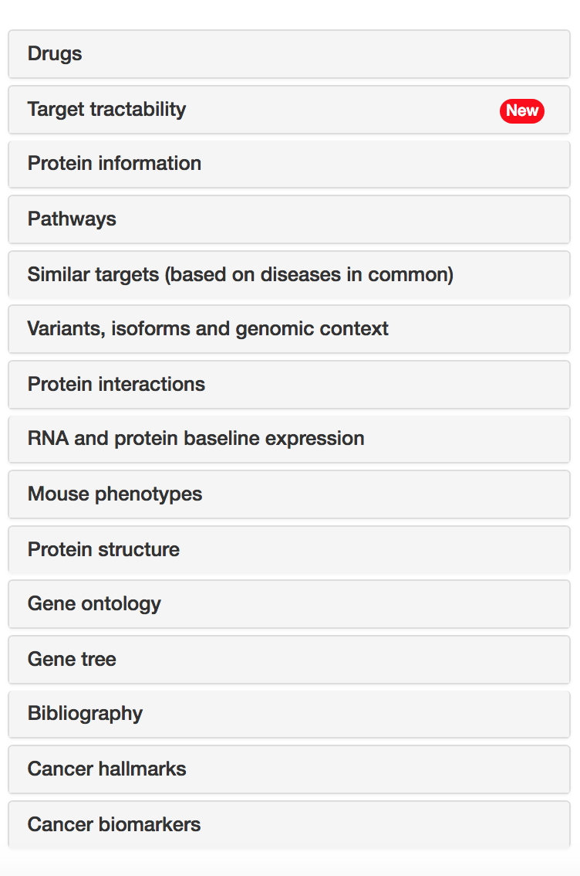







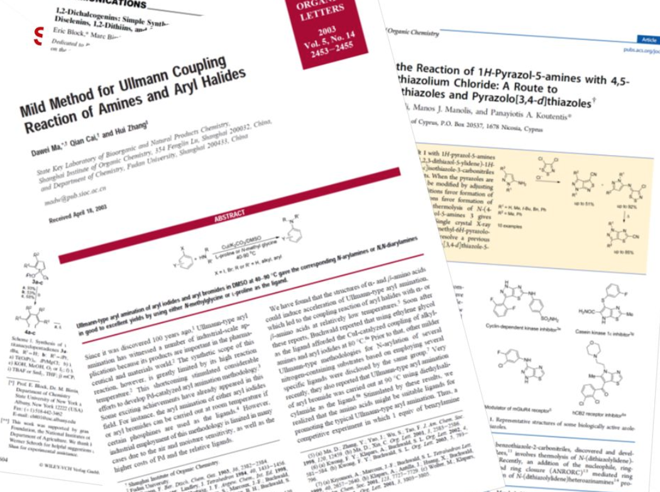


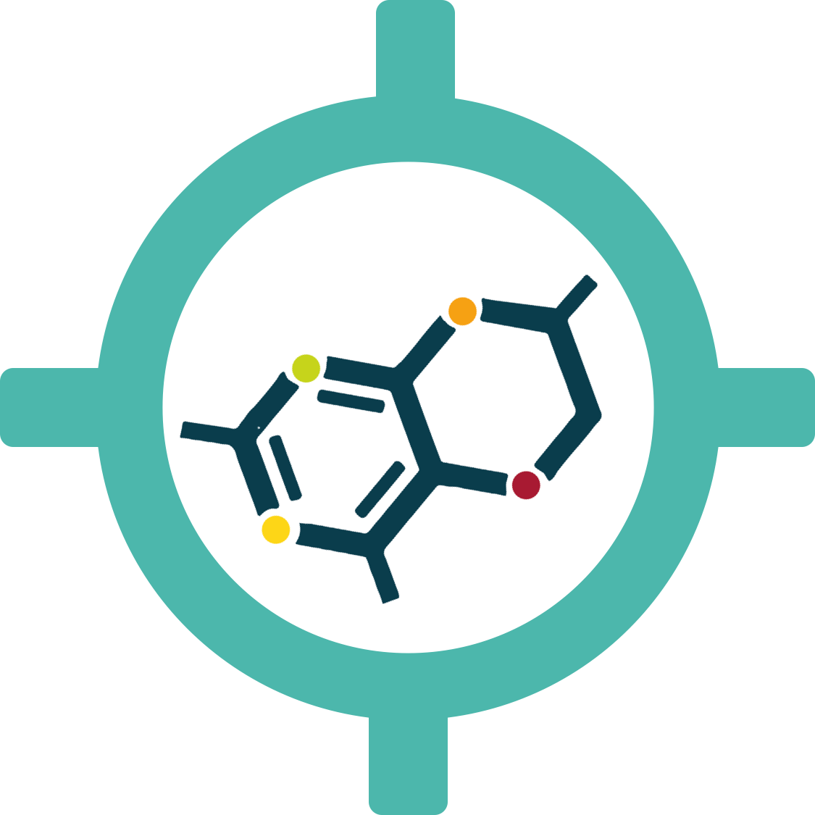





Target annotations
Target
profile page
https://docs.targetvalidation.org/getting-started/getting-started/target-profile

Slide 30
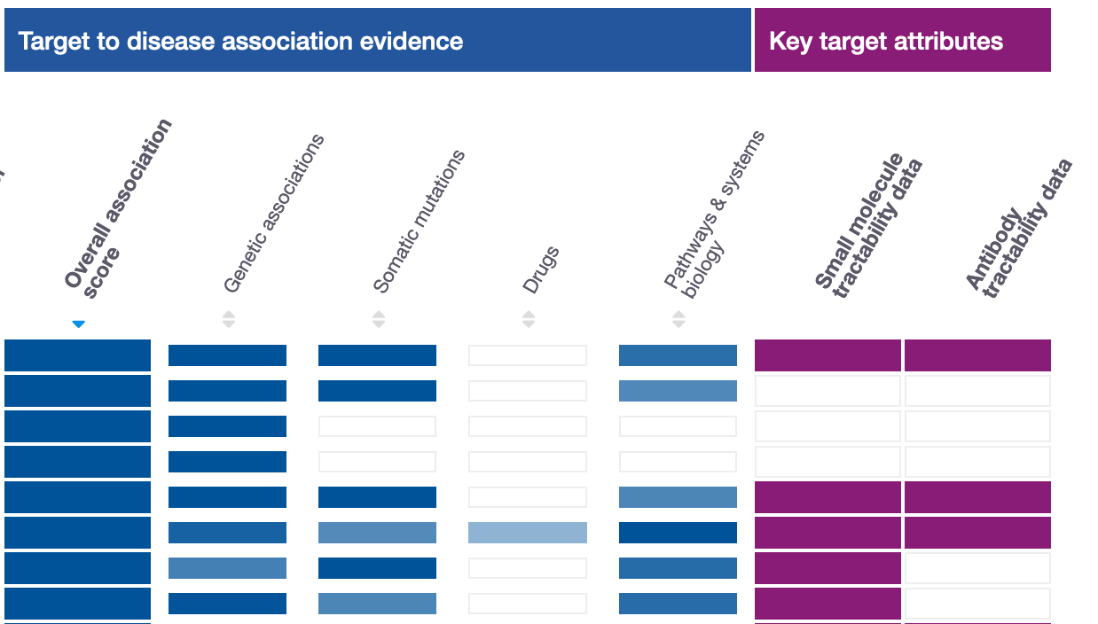
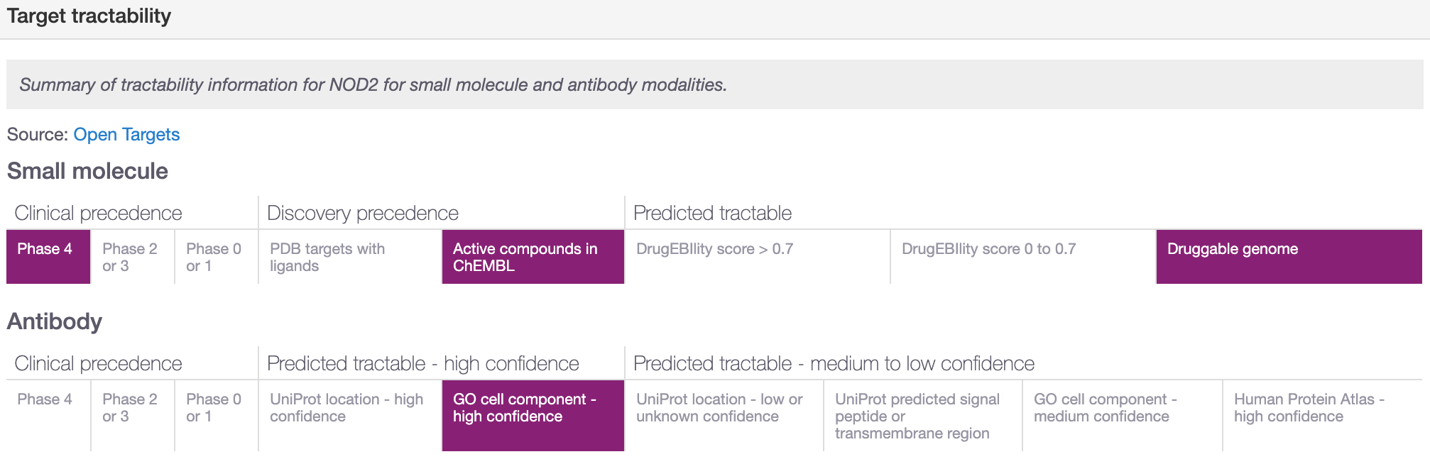
Is my target tractable?

Slide 31
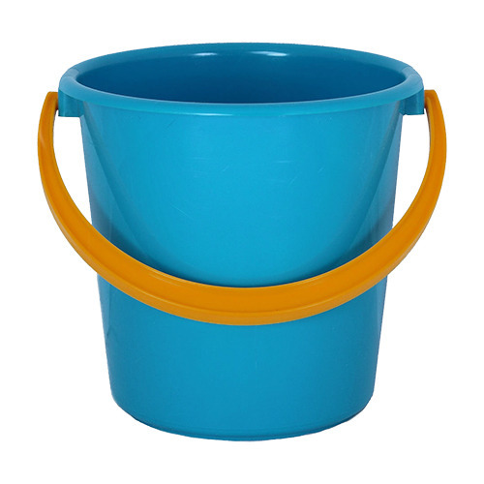

Target tractability buckets
1
2
3
4
5
6
7
8
2
3
4
5
6
7
8
9
1
9
Clinical phases e.g. phase IV (bucket 1)
Cellular localization e.g. plasma membrane (bucket 4)
DrugEBIlity – ensemble score e.g. > 0.7 (bucket 5)
GO cell component (plasma membrane)
1

Slide 32
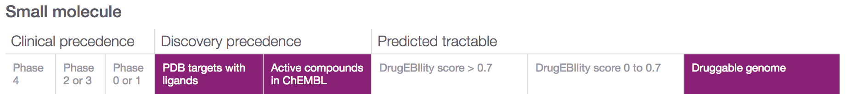
Target tractability – small molecules
Clinical precedence:
Discovery precedence:
Predictable tractable:
1
2
3
4
7
5
6
8
1
2
3
4
7
5
6
8

Slide 33
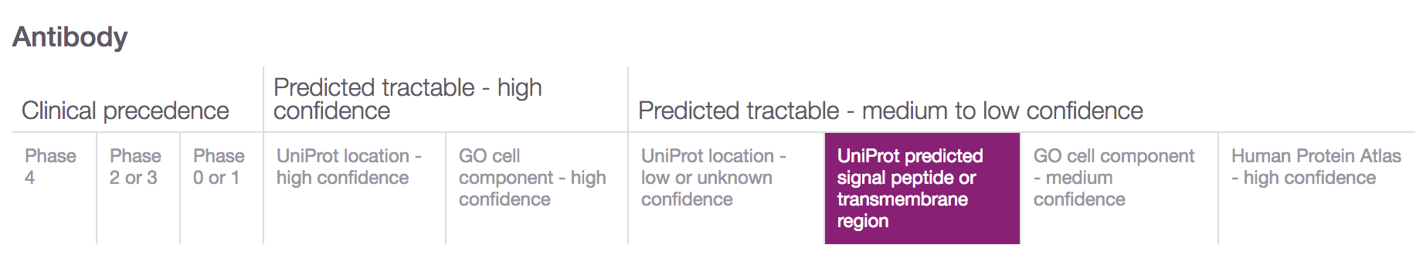
Target tractability – antibodies
Clinical precedence
Predictable tractable
– high confidence
Predictable tractable
– med-low confidence
1
2
3
4
5
6
7
8
9
9
1
2
3
4
5
6
7
8
9

Slide 34
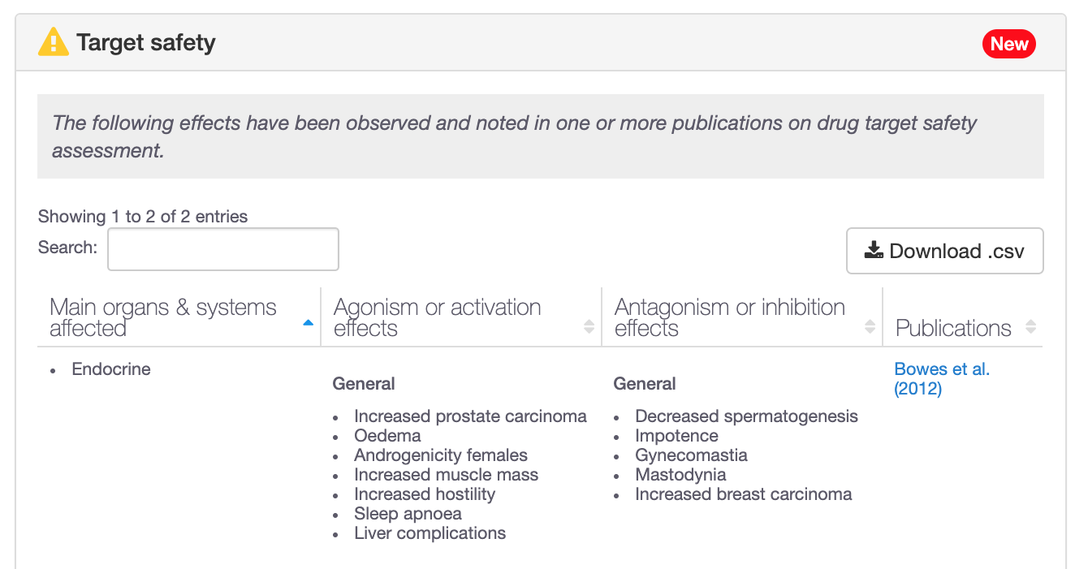
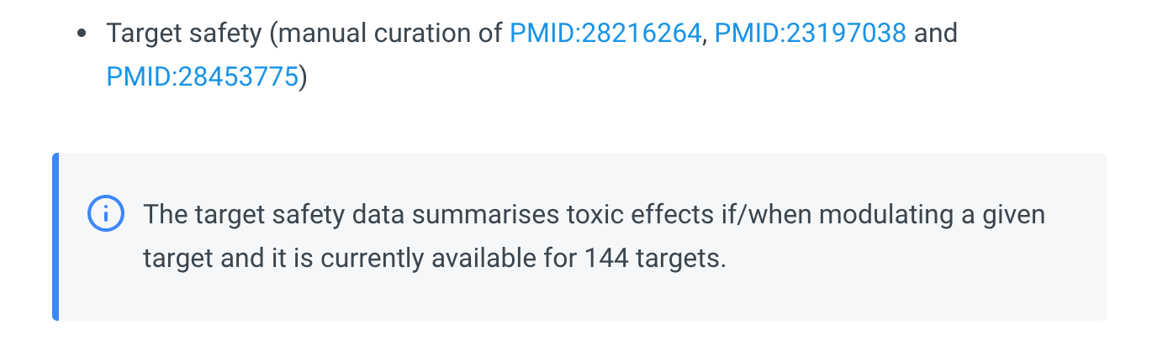
Is my target safe?
Target
profile page
https://docs.targetvalidation.org/getting-started/getting-started/target-profile

Slide 35
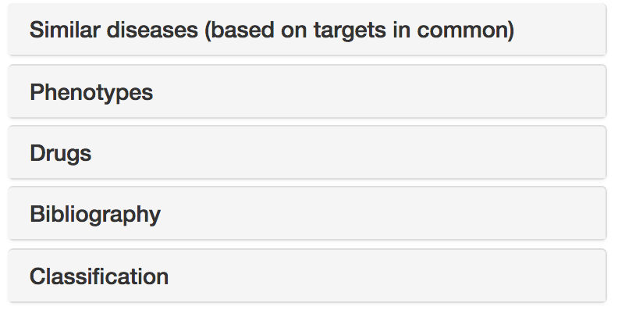


Disease annotations
Disease profile page
https://docs.targetvalidation.org/getting-started/getting-started/disease-profile

Slide 36
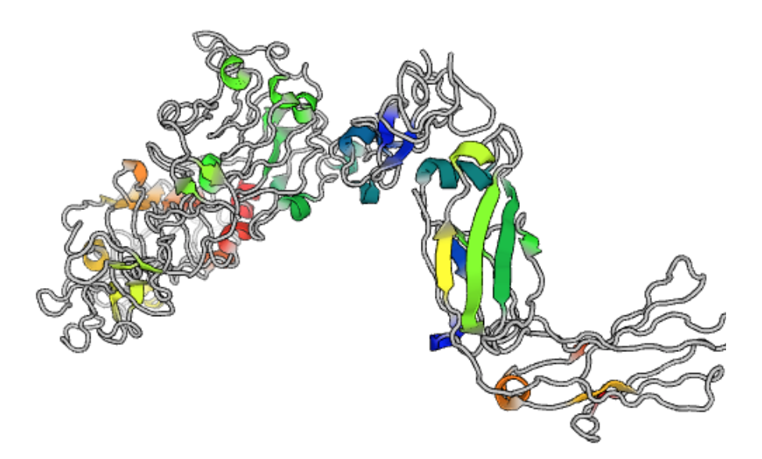
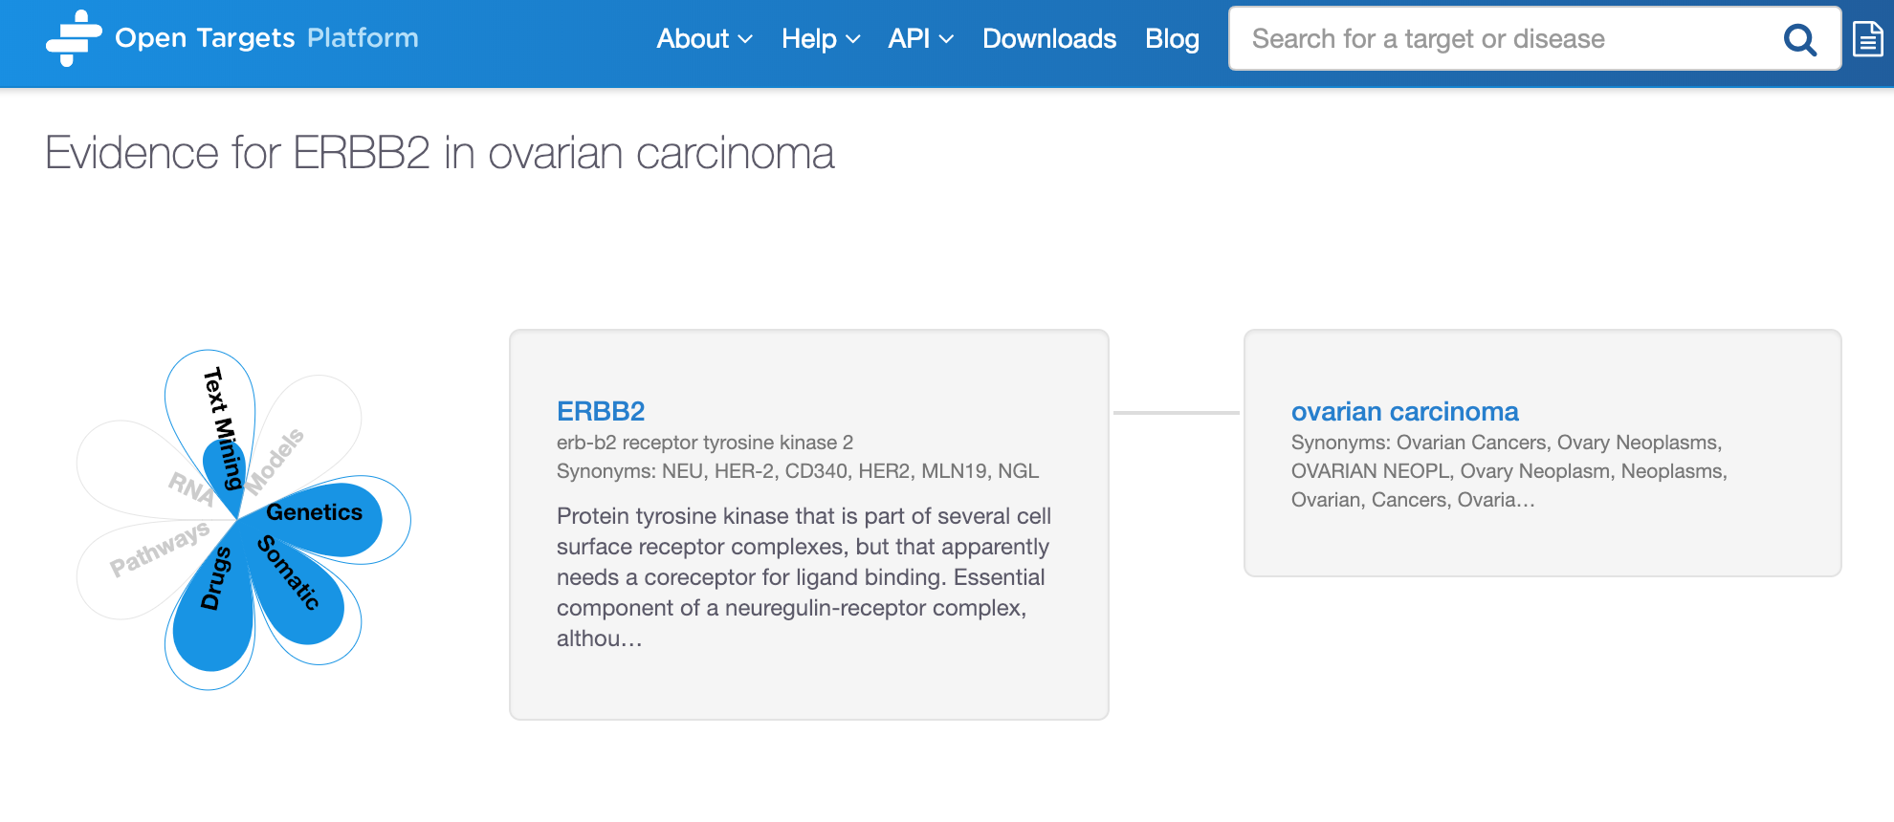
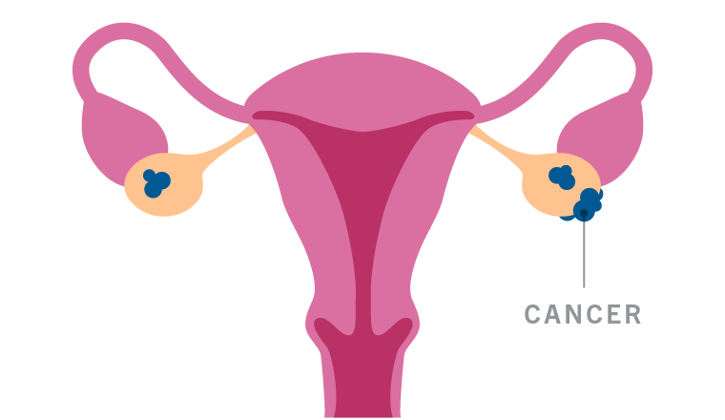
Demo 2
Target and disease annotations
Target
profile page
Disease profile page

Slide 37
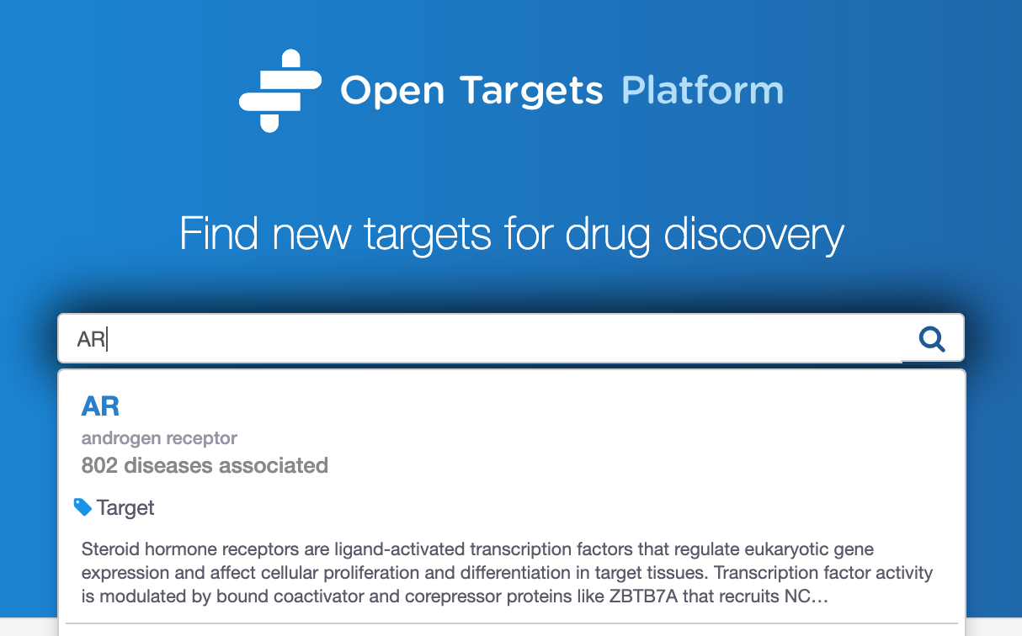
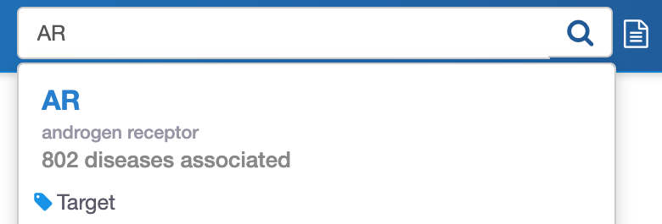
Demo 3
Searching for a target → diseases
Which disease associations are available for my target?

Slide 40
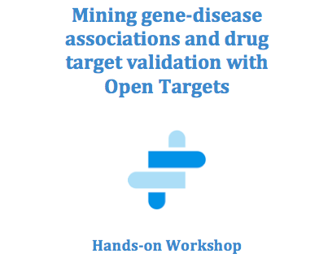
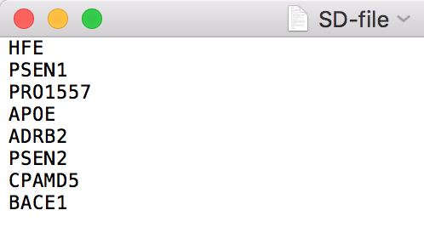
Hands-on exercises 1-4
Pages 25-28
Or feel free to explore your target (gene/protein) and disease of interest
https://tinyurl.com/exercises-c4x

Slide 41
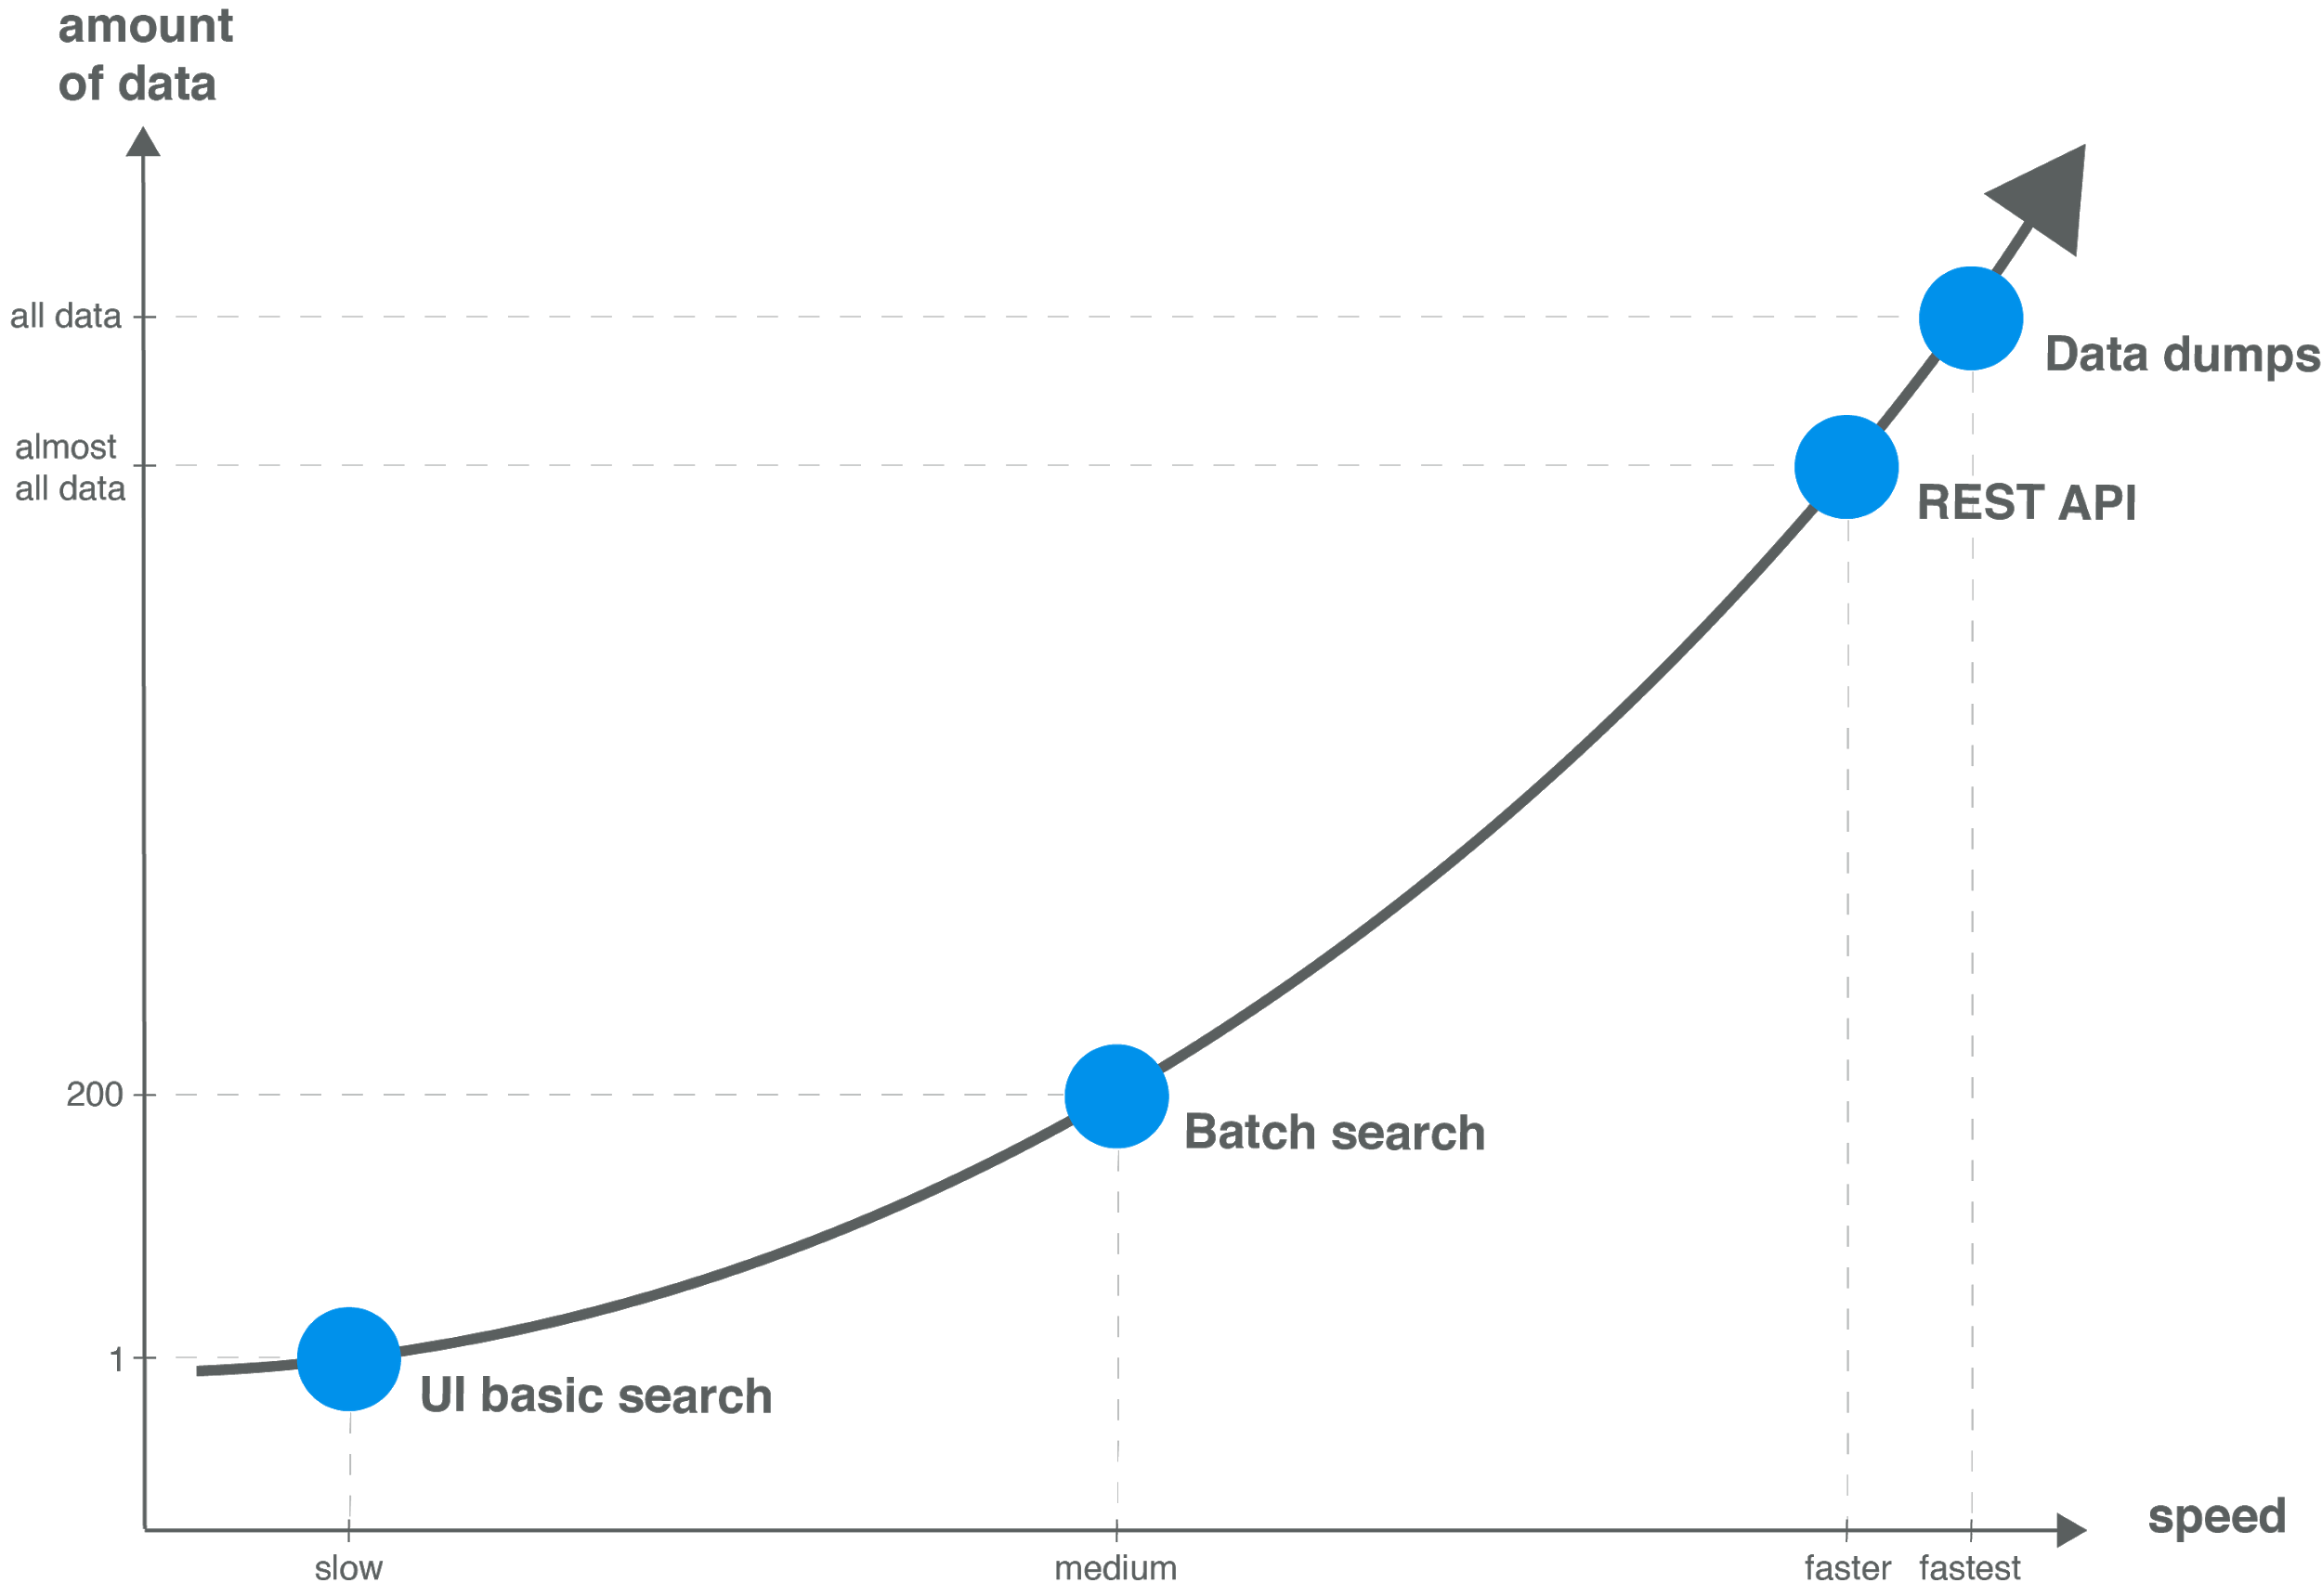
Modes of access → data volume

Slide 42
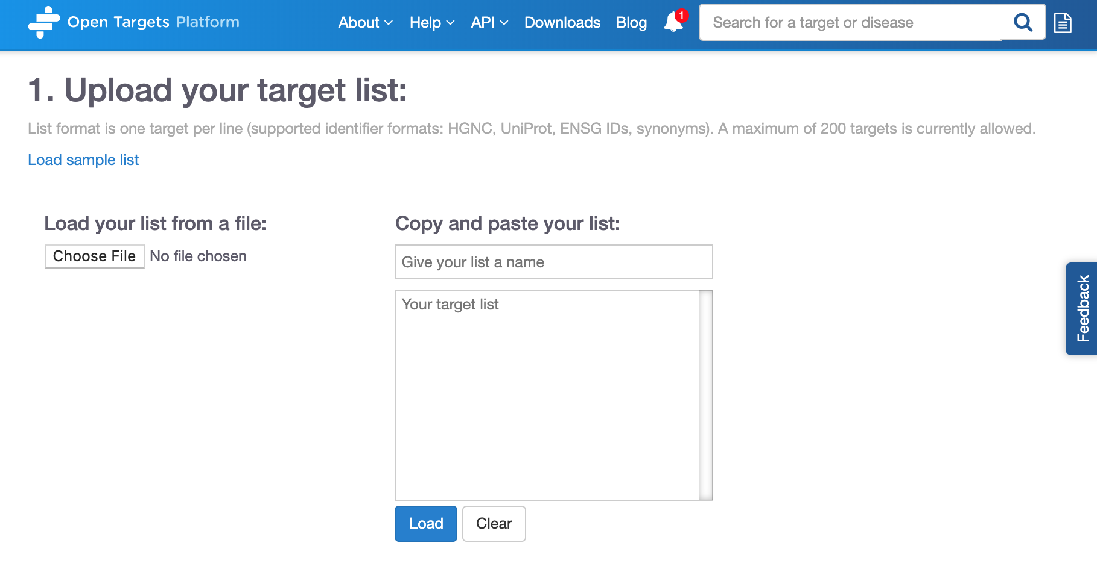
Batch search
https://www.youtube.com/watch?v=CPkAxnVrt_s

Slide 43
Several targets at once
We have a list of 20 possible targets for multiple myeloma.
We would like to know if these targets are represented in other diseases.
Are there any pathways over
represented in my set of targets?
https://www.targetvalidation.org/batch-search

Slide 45




Open Targets Platform REST API*
Server
https://platform-api.opentargets.io/v3/platform/
Endpoint
public/association/filter
Parameters
?target=ENSG00000163914&size=10000&fields=target.id&fields=disease.id
Open Targets Python client **
*
https://docs.targetvalidation.org/tutorials/rest-api
**
https://docs.targetvalidation.org/tutorials/python-client

Slide 46


User interface or REST API?
Scale and volume of your search or results
Flexibility in the search
Visualisation of the results
Notes:
http://api.opentargets.io/v3/platform/public/evidence?id=d0ad72d0e798449346de04eb3b189e10

Slide 47



How to search
https://platform-api.opentargets.io/v3/platform/public/search?q=PTEN

Slide 48



How to get all diseases associated with a target
http://platform-api.opentargets.io/v3/platform
/public/association/filter?
target=ENSG00000171862
&direct=true

Slide 49



How to get the score for an association
http://platform-api.opentargets.io/v3/platform/
public/association?id=ENSG00000171862
-EFO_0000616
Notes:
http://platform-api.opentargets.io/v3/platform/public/association?id=ENSG00000171862-EFO_0000616
http://platform-api.opentargets.io/v3/platform/public/association/filter?target=ENSG00000171862

Slide 50



How to get the evidence for an association
http://platform-api.opentargets.io/v3/platform/public/evidence/filter?target=ENSG00000198947&disease=Orphanet_98896&datatype=genetic_association

Slide 51


Data downloads

Slide 52

REST API
https://youtu.be/KQbfhwpeEvc
https://docs.targetvalidation.org/programmatic-access/rest-api

Slide 53
Extra hands-on exercises E1-E4
Pages 29-31
Or feel free to explore your target (gene/protein) and disease of interest
https://tinyurl.com/exercises-c4x

Slide 54
Data integration: web resources
Data integration: Open Targets
https://www.opentargets.org/resources/#open-targets-platform

Slide 55

Open Targets Genetics. Why?
Refine genetic associations in the Open Targets Platform
Make sense of GWAS
Glimpses of the biology behind the association
Guide target ID?
Lee et al (2017): PMID:29288389
Notes:
Mechanism behind GWAS signal…
Improve map of GWAS signal and gens (behind)

Slide 56


Genetics increases success
Both common and rare variants
Notes:
Mechanism behind GWAS signal…
Improve map of GWAS signal and gens (behind)

Slide 57

Key question
Which targets are implicated in disease from common variant genetic analysis?
https://genetics.opentargets.org

Slide 58






Open Targets Genetics: data sources
Human genetics
Variant (GnomAD) – Trait (study)
Functional Genomics
Variant – Gene
Sun et al. 2018
*
**
***
SNP-trait
associations
Full summary statistics
Neale and colleagues v1
337,199 individuals
2,419 traits
Ensembl
VEP
* Javierre et al. 2016
** Andersson et al. 2014
*** Thruman et al. 2012
https://genetics-docs.opentargets.org/our-approach/data-sources
Notes:
Data with summary stats→ fine mapping
Data with no summary stats → LD
More associations in Genetics than PostGAP (plus additional data pQTLs)

Slide 59
Open Targets Genetics: data model
r²
Posterior Prob.
Aggregated functional score
S
p-value
V_{L}
V_{T}
G
GWAS Catalog
UK Biobank
Fine mapping
LD expansion
TSS distance
eQTL (GTEx V7)
pQTL
PCHI-C
FANTOM5
VEP
S Study (traits from UK Biobank and GWAS catalog)
V_{L} Lead variant (associated with traits from GWAS catalog)
V_{T} Tag variant (possible causal, expanded from V_{L})
G Gene
https://genetics-docs.opentargets.org/our-approach/pipeline-overview

Slide 60
What can you do with Open Targets Genetics?
V
S
G
Variant
Trait
Gene
Genes functionally implicated
Variant association across traits (PheWAS)
Variants tagged
Independently associated loci
Overlapping susceptibility loci
Associated traits
Links to drugs, expression, pathway, mouse phenotype, etc in Open Targets Platform
Locus plot
Visualising the associations between traits, variants, and genes
Fine mapping analysis

Slide 61




How to access all this data?
User interface
https://genetics.opentargets.io/
GraphQL API
http://genetics-api.opentargets.io/
Bulk download*
* http://blog.opentargets.org/2019/04/09/open-targets-genetics-release-is-out/

Slide 62
Wrap up
Public data
Experimental projects
Bioinformatics projects
DATA
GENERATION
DATA
INTEGRATION
Therapeutic hypothesis
https://www.targetvalidation.org
https://genetics.opentargets.org
Notes:
Target ID and prioritisation knowledge cycle.
Our research focusses on data generation, data integration, and enabled data access
Our research is connected as we provide the tools to generate hypothesis and explore them experimentally
We focus primarily on oncology, immunology (including IBD) neurodegeneration with some experiments in other areas or across diseases

Slide 63






Upcoming data
50K exome sequence data
Community
ML model: learn the weight to give to the different data sources e.g. VEP
Notes:
Increase the comprehensiveness of disease ontology (include MONDO terms)
Create drug index so that partners can add their private compounds/info
Replace GWAS evidence by Open Targets Genetics functional genomics data
Open Targets Genetics score: AI to learn

Slide 64


How to cite us
http://bit.ly/cite-us

Slide 65




Get in touch
Open Targets Platform | Open Targets Genetics
docs.targetvalidation.org | genetics-docs.opentargets.org
support@targetvalidation.org | geneticsportal@opentargets.org
@targetvalidate
blog.opentargets.org/
http://tinyurl.com/opentargets-in
https://tinyurl.com/opentargets-youtube

Slide 66










Acknowledgements

